Slide 1
Big Data Analytics Project
Personalising the shared space Airbnb Recommendation Ramp-up
Submitted By
Nikhita Wadhawan
Riddhi Jain
Snehal Thakur
Notes:
Hello Everyone, My name is Nikhita and i will be presenting our project on behalf of our group. Our project is an approach to personalise Air Bnb recommendation and the team comprised of Riddhi Jain, Snehal Thakur and myself. We are aware that Recommender systems have the capability to reduce the information overload by estimating relevance for searches.

Slide 2
Problem setting
Something old
Something new
Personalised
Rental Recommendations
Listings
Customers Reviews
Something borrowed
Something blue
Notes:
We wanted to use collaborative filtering and utilise the data for AIRBNB listings and reviews to create personalised recommendations for reviewer which are similar in rating to what they’ve liked before

Slide 3
Data source: California
Los Angeles
San Diego
(Link provided at the bottom*)
San Francisco
*http://insideairbnb.com/get-the-data.html
Notes:
We miss the California sun dearly in Chicago, so we decided to use the dataset for 3 major cities in the State of California. Los Angeles, San Diego and San Francisco . The website, Inside airbnb offers multiple data sets extracted from airbnb for various popular cities on the Airbnb Platform worldwide. You can find data related to listings, reviews, neighbourhoods and calendar bookings .

Slide 4
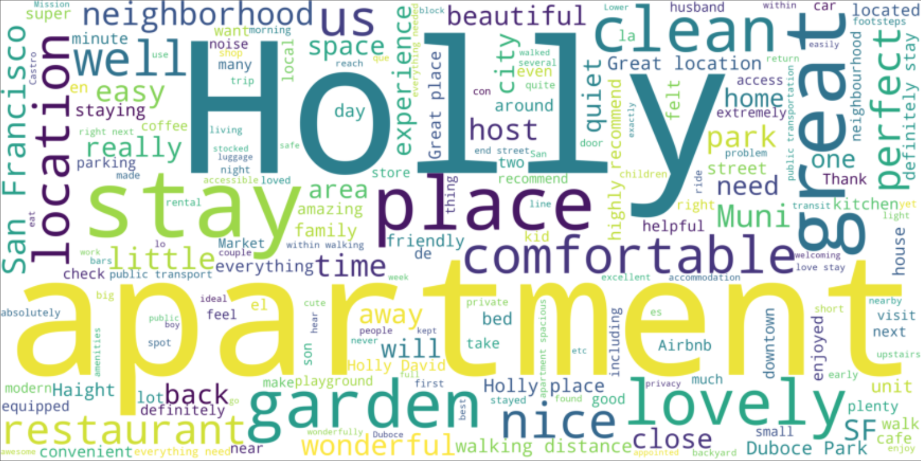
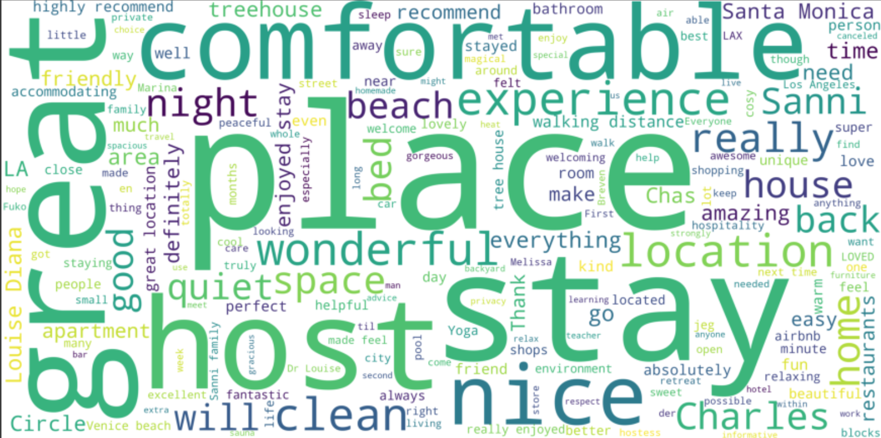
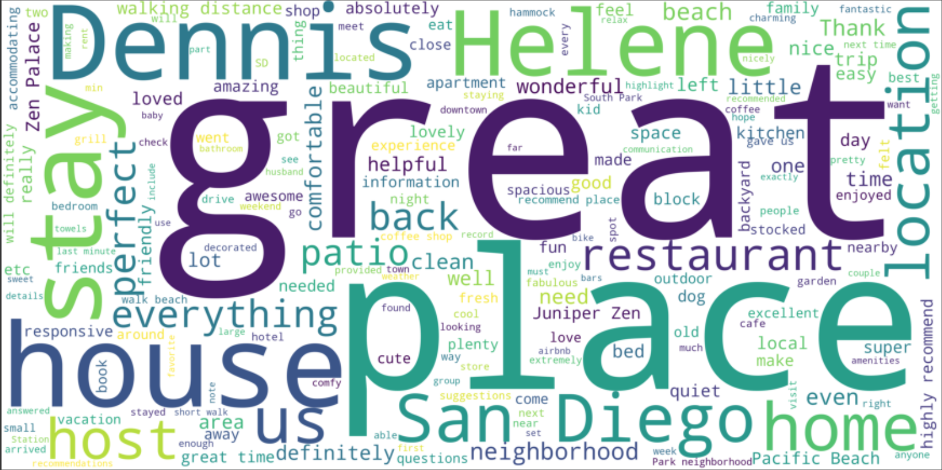
Data Exploration
High number of variables with high correlation.
Every city has different features in the accommodation that the tourists prefer.
Every city has different geographic preference that the tourist prefers.
2 Million Rows
106 Columns
San Francisco Comments
80 Neighbourhoods
Word Clouds
Histograms
Scatterplots
Corr Plots
Los
Angeles Comments
San
Diego
Comments
Notes:
Before we went ahead with building the recommendation system, we wanted to take a moment to explore the data at hand. We built wordclouds to identify what kind of neighbourhoods are there in the three cities, what kind of properties are more popular, what amenities are more in demand and the likes. We also used scatterplots, histograms and corr plots to get more detailed information. We observed that, there is a high number of variables with high correlation, every city has different features that people prefer, for Example, a user looking at a listing in LA prefers a stay by the beach, while someone looking at a listing in San Francisco, prefers an apartment with the Golden gate bridge view and proximity. Overall, every city has a different geographic preference that the user prefers

Slide 5
Techniques used
ALS
Recommender Systems
Spark
Pandas
NLTK
VADER
Notes:
For the recommendation system, we wanted to have a big enough dataset so we merged the information from all 3 cities to create a California reviews dataset. But we also faced the challenge, that our dataset does not have review ratings . We then utilised the comments section to analyse the sentiment for the reviews. We cleaned the text and used tfidfvectoriser to compute the word counts, idf values and tf-idf scores and created a feature matrix. Following this, we used Sentiment Intensity Analyser with Valence Aware Dictionary and Sentiment Reasoner (ALSO abbreviated as VADER - a lovely wordplay for the STAR WARS Fans), to generate a compound score between -1 and 1, with 1 being most positive, WE used these polarity scores to assign a rating from 1-5 to the reviews data.
We now used our review data with the ratings to create a spark dataframe, with the reviewer id, listing id and polarity rating. We randomly split the data into an 80-20 training-test ratio and build a model on training set using Alternate Least Squares method. We did come across a cold start but we utilised the cold start strategy option in ALS to overcome the issue. Our initial RMSE value was high, so we retrained the model using cross validation to get the best fit and were able to reduce the rmse by 15%.

Slide 6
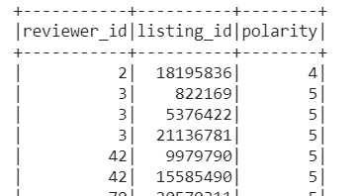
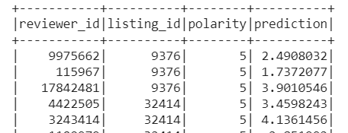
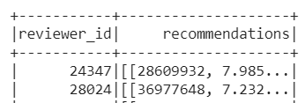
Conclusion
Future Scope
Create a hybrid system by incorporating more data sources
Add an item dimension by using amenities ratings for listing and created a super score with the reviews rating
Incorporate search history to identify what the user is looking for frequently
Notes:
We finally calculated our prediction values and generated the TOP 5 recommendations of listings for each reviewer and extracted the results in a csv file. A view is provided in the screenshot above. We liked working on this project and wanted to add more functionality in this so we planned a future scope shared above. This is our project. and thank you for giving your time and viewing our work!

