Slide 1
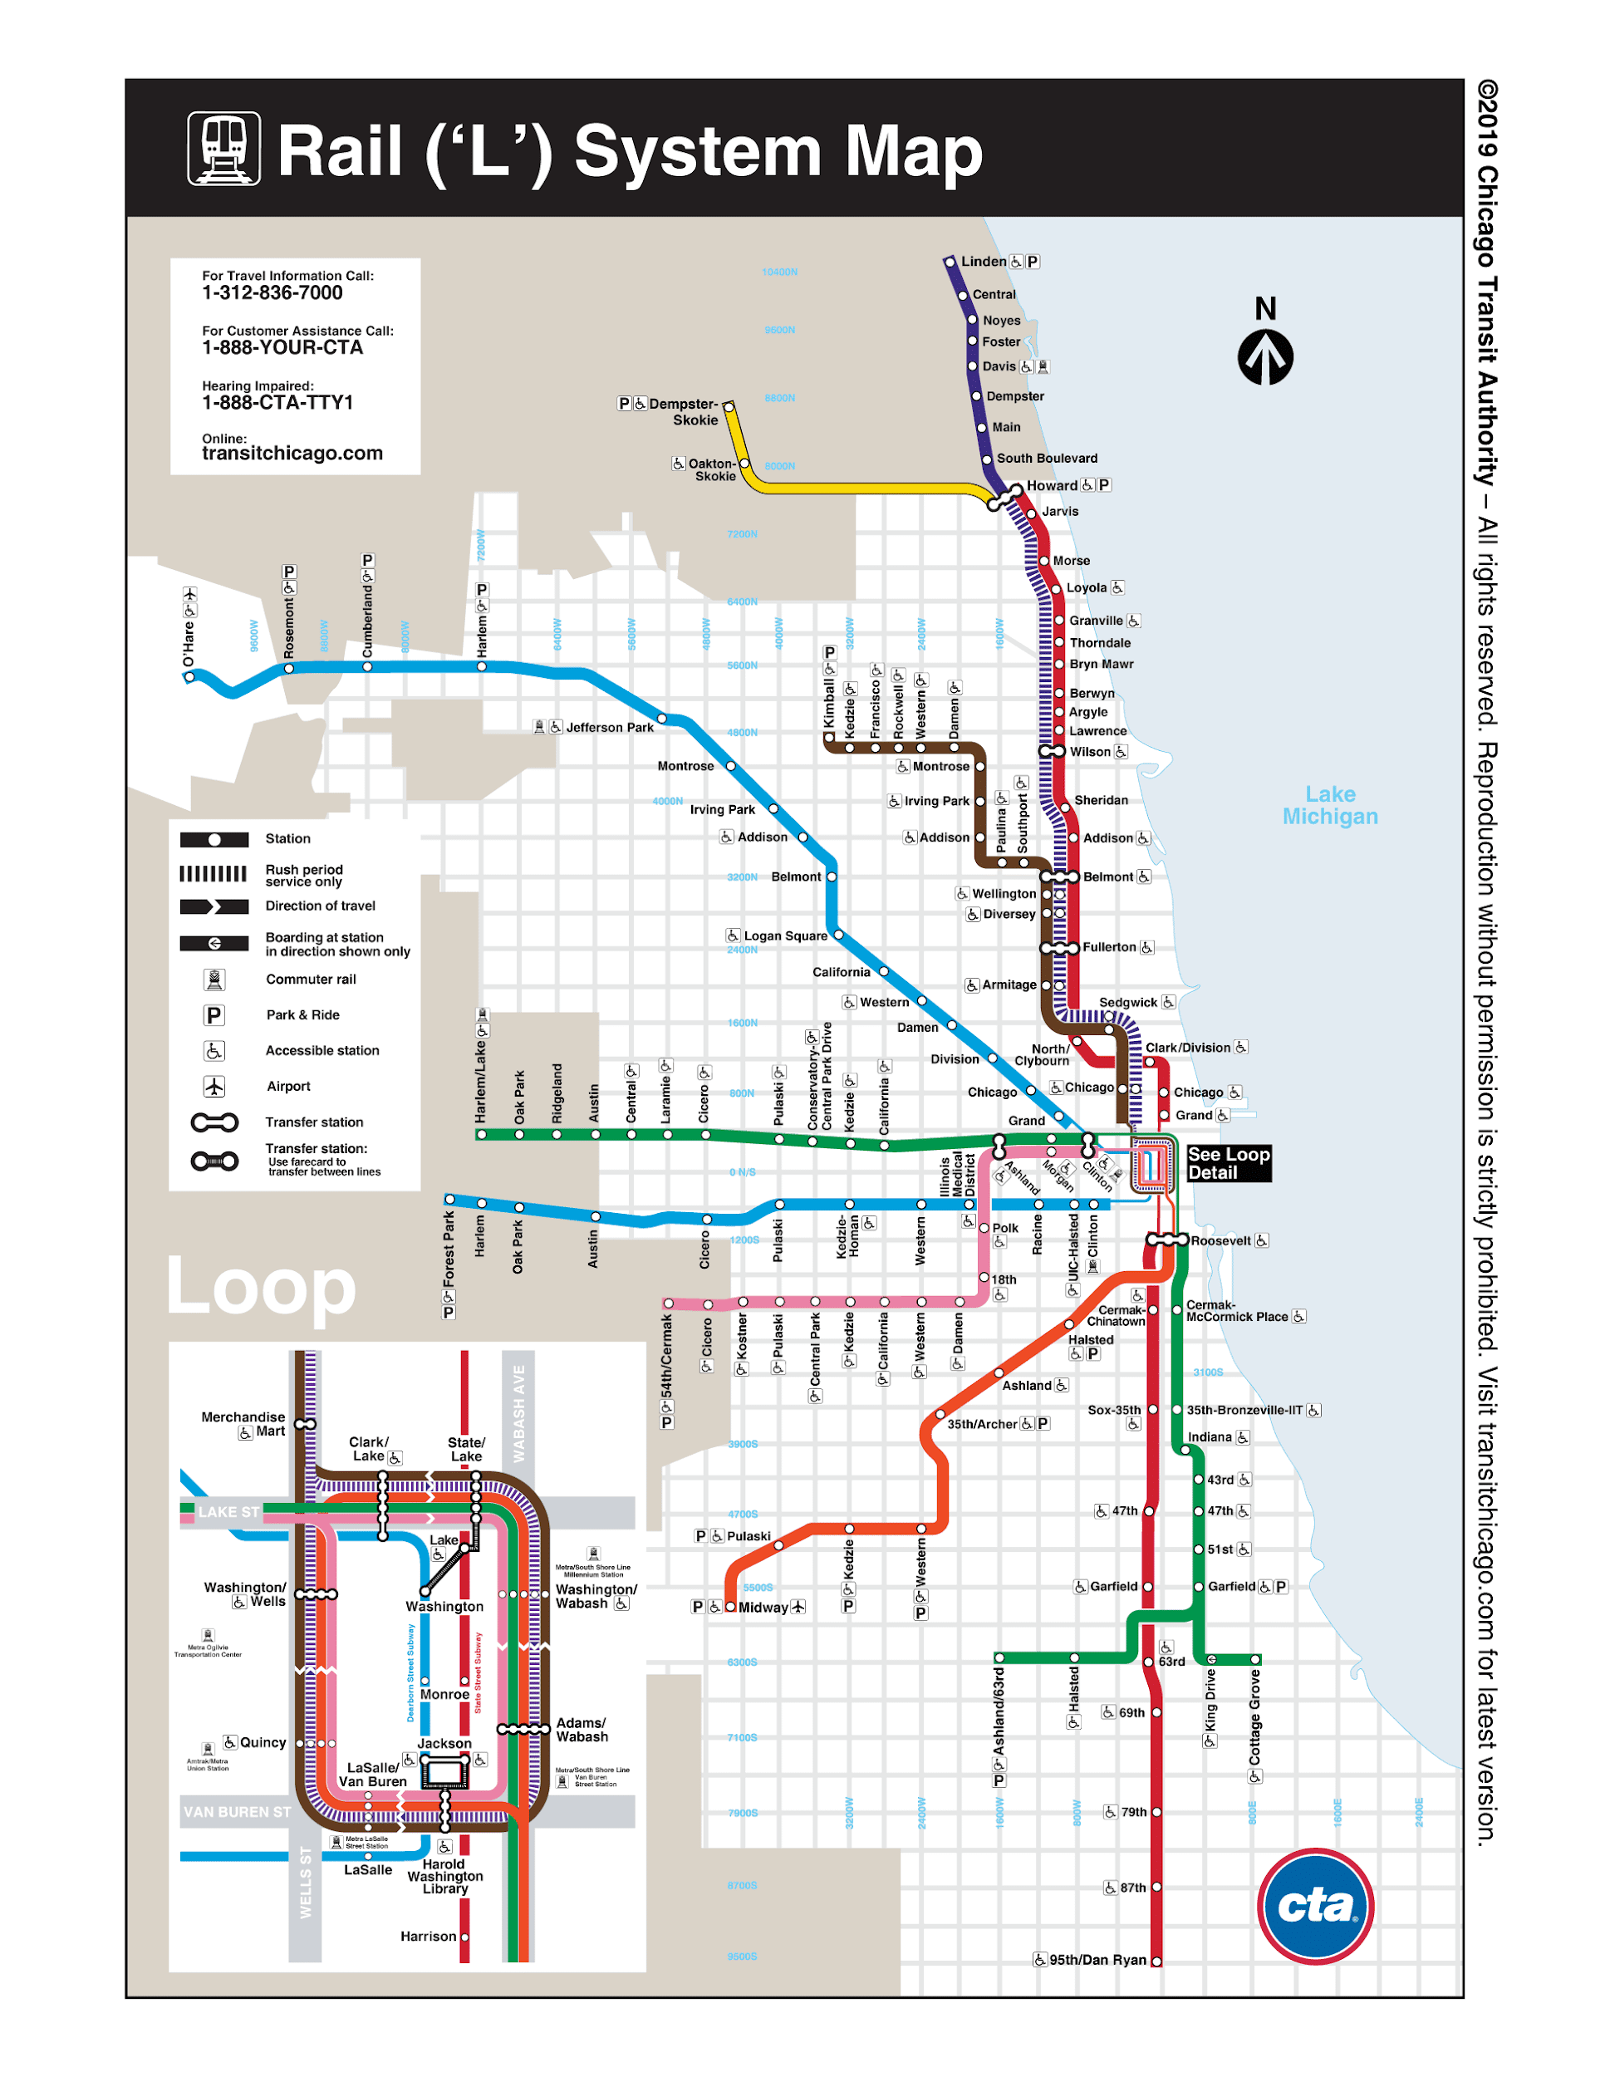
CTA OPERATIONS
ANNA SHAJI
RIDDHI JAIN
SAJAL JOSHI
SCOTT BREWER

Slide 2
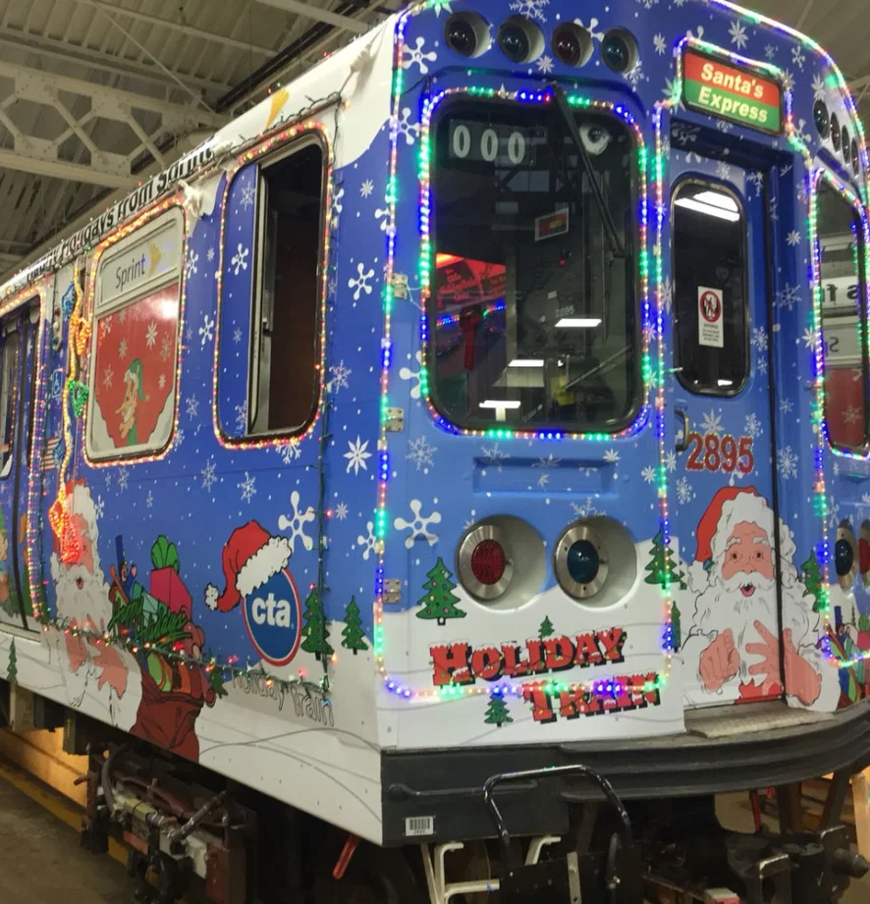
INTRODUCTION
Build a process that creates a valid General Transit Feed Specification (GTFS) file from CTA's existing sources.
Analyse the factors causing bus bunching.

Slide 3
Background
CTA operates the nation’s second largest public transportation system
On an average weekday, 1.6 million rides are taken on CTA
It serves 35 suburbs, in addition to the City of Chicago
CTA has 1,864 buses that operate 129 routes and 1,536 route miles
Buses make about 19,237 trips a day and serve 10,768 bus stops
CTA’s 1,492 rail cars operate eight routes and 224.1 miles of track
CTA trains make about 2,318 trips each day and serve 145 stations

Slide 4
Final Deliverables
GTFS Files
Bus Bunching Model

Slide 5
Business Problem
GTFS Hard to Maintain
GTFS has become standard for transit companies to share schedules
Internal files are periodically converted to Public GTFS
Process uses decade old, complicated SQL code (not provided)
Requested Solution
Develop maintainable conversion process
Use Python and Pandas (due to CTA team familiarity)
Deliverables
Python script to generate two sets of GTFS files with internal and public data and with with only public data
Jupyter notebook with all script functions plus diagnostic functions

Slide 6
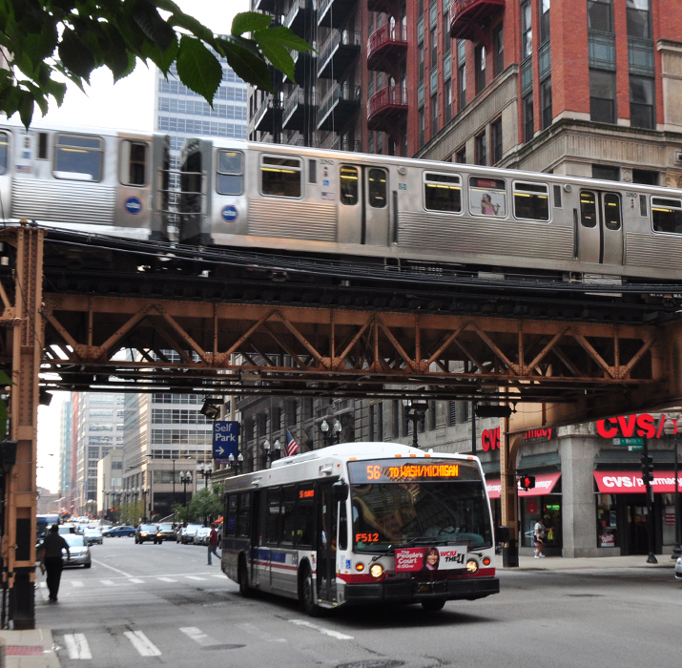
Data Description
Two Sources
Internal CTA Scheduling Data
Public GTFS Files
Both Contain
Scheduling Data
Stop Times
Trip Information
GIS data
Stop information (location, IDs)
Route Shapes (spatial paths)
System Information
Route Information (Route names, color)
Agency (agency contact info)

Slide 7
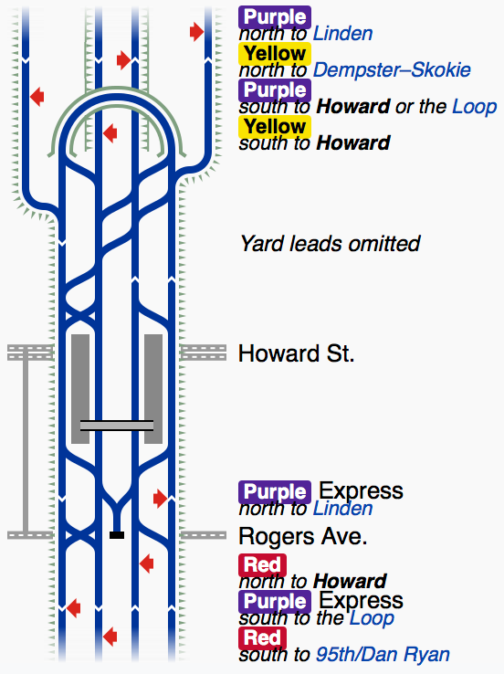
Issues
Complicated System
Variable Station Service and Layout
Inner and Outer tracks
Single vs Multiple Lines
Unmarked Internal and External Data
Mismatched Primary Keys
Keys differ between internal source tables
Many keys differ between internal and GTFS sources
Variable naming conventions
Unavailable Internal Data
No internal shapefile, only public gtfs shapefile (different keys)

Slide 8
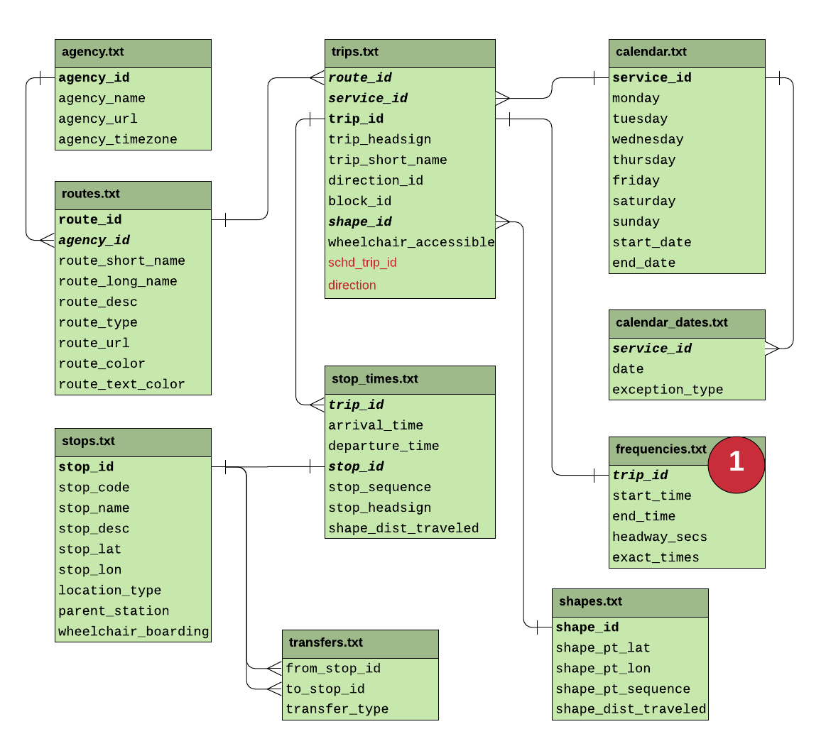
GTFS Schema

Slide 9
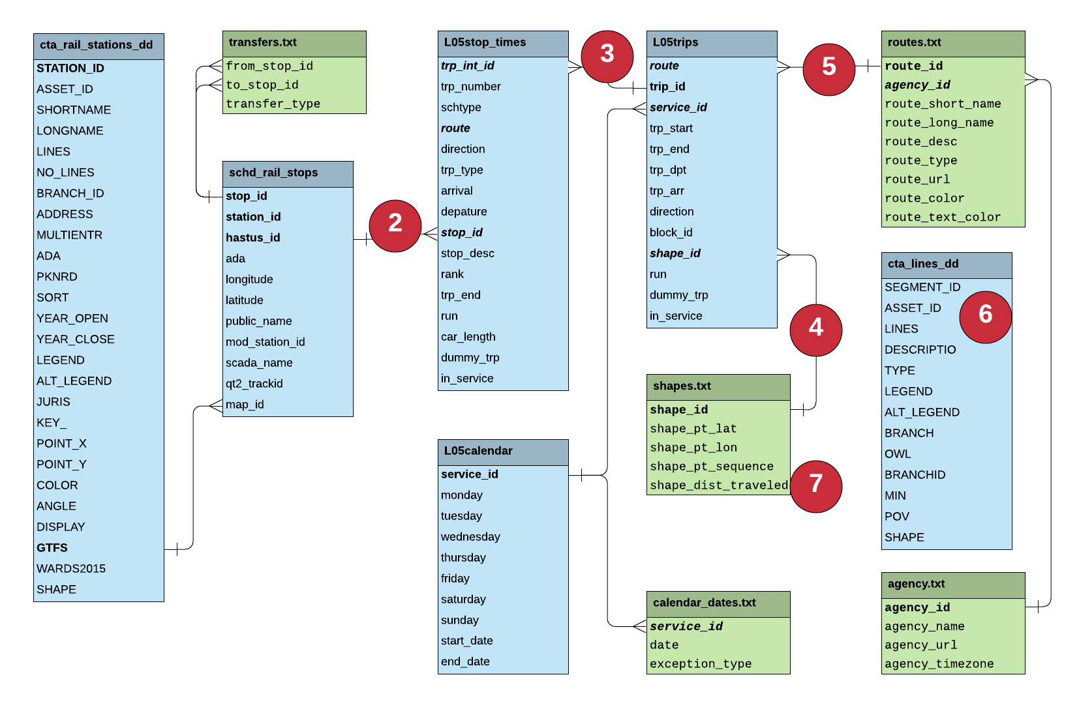
Proposed Schema

Slide 10
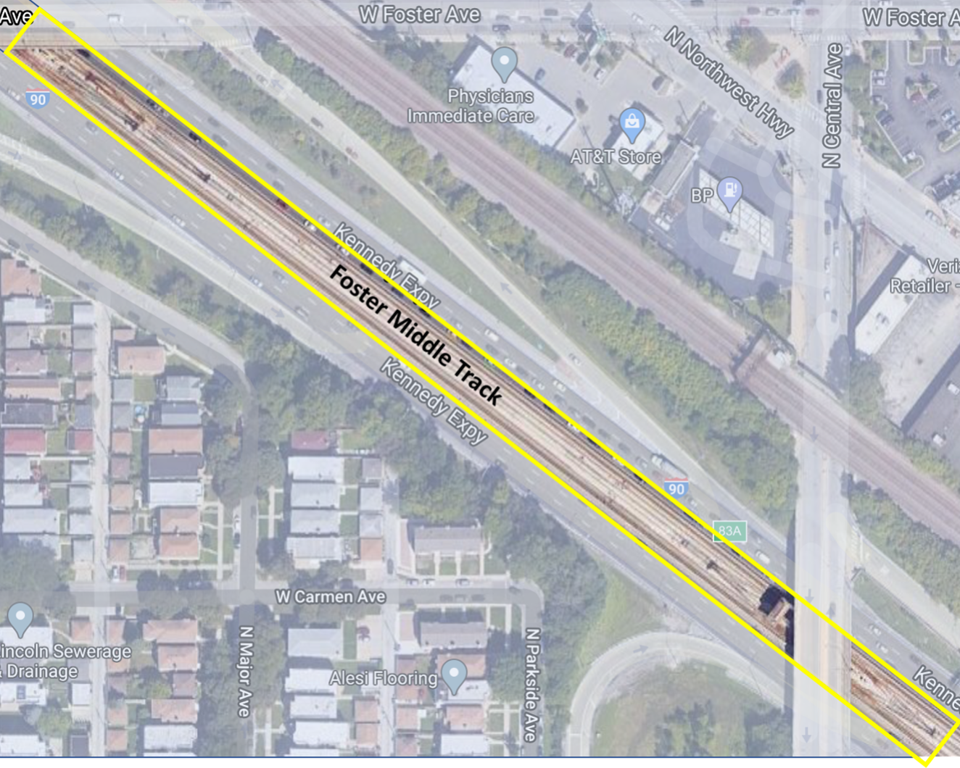
Solutions
Complicated System
Read all data as strings
Avoids potential drop of lead zero in IDs
Reduces TypeErrors
Typecast as needed
Variable Service and Layout
Group and Filter
Research outliers
Can’t just exclude outliers
Unmarked Internal vs External
Joins and Groups
Satellite imagery inspection
General research on CTA history

Slide 11
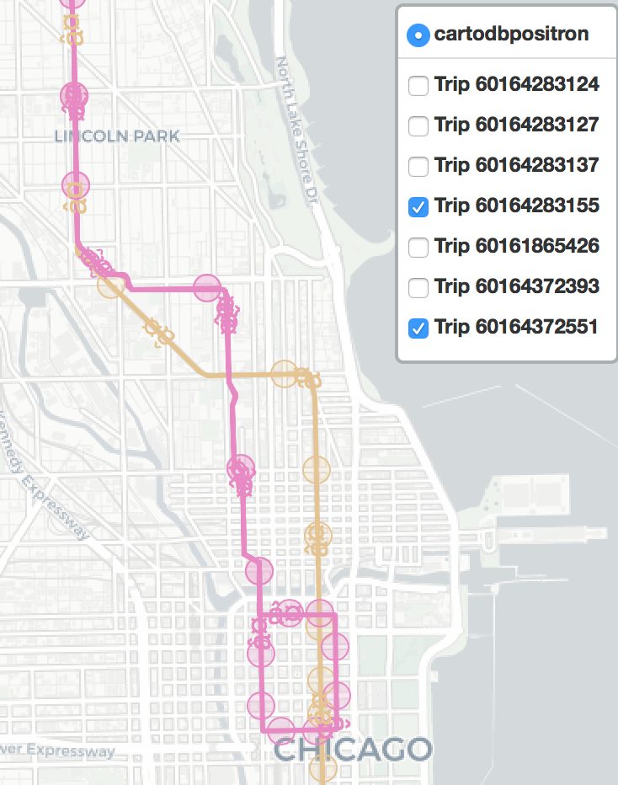
Solutions
Mismatched Primary Keys
Outer Join and Group
Manage N/As!
String Manipulation
Fuzzy and difflib matching
Common difference identification
Use system knowledge
Manual Inspection
Unavailable Internal Data
Leverage existing packages like gtfs_kit to visually inspect public GTFS data
Make and compare similar groups in internal vs external files
Match up overlapping shapes
Data simulation

Slide 12
Example - Common Key Mismatches
Stop Times | Stop Times Stop Name | Master Platforms | Master Stop Name | Identified Difference
rt00202n | Harlem/Lake-Green North | rt0020w | Harlem-Lake-West | green n/w swap
rt00302s | Pulaski/Lake-Green South | rt0030e | Pulaski-Lake-East | green s/e swap
rt0048w | Cicero-Lake West | rt0480w | Cicero-Lake-West | shifted station_id
rt01902N | 35th Red Northbound | rt0190Rn | Sox-35th-Dan Ryan-North | 2/R swap
rt02902n | Ashland/West 63rd-Green North | rt0290w | Ashland/63rd-West | multi insert2
rt0320n1 | Division/Milwaukee Northbound | rt0320n | Division/Milwaukee-North | blue append1
rt0765n | Granville Red Line north | rt0760n | Granville-North | red 0/5 swap
rt0970n1 | Cicero/Congress Northbound | rt0970e | Cicero-Congress-East | blue n/e swap
rt0970s1 | Cicero/Congress Southbound | rt0970w | Cicero-Congress-West | blue s/w swap

Slide 13
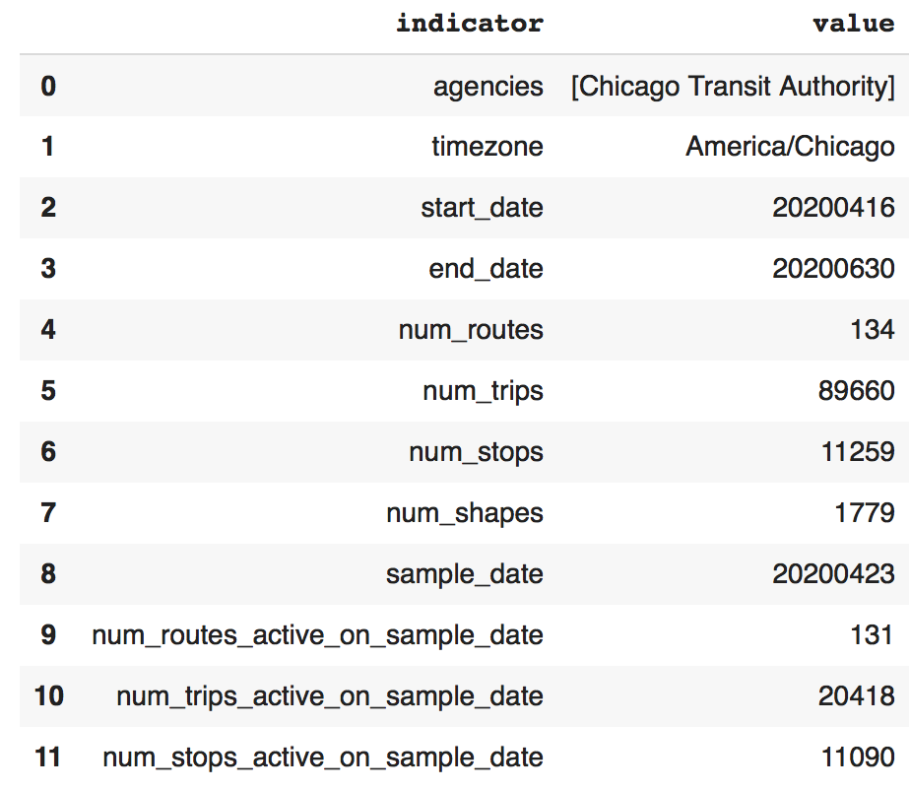
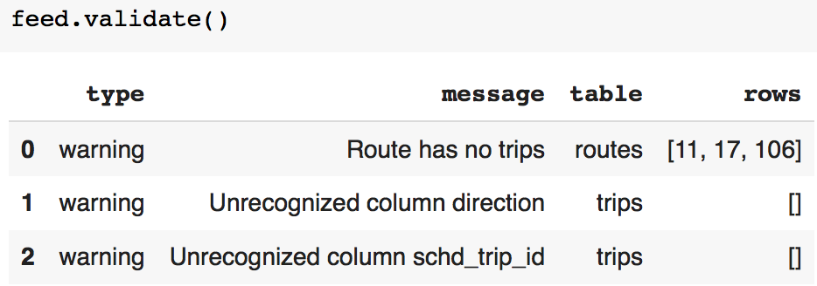
Business Benefit & Future Improvements
Benefits
Maintainable Conversion Process
Eventually!
Python GTFS Ecosystem
Better Schedule Change Notification
Future Improvements
Link process to online databases to automate process
Extend to bus system

Slide 14
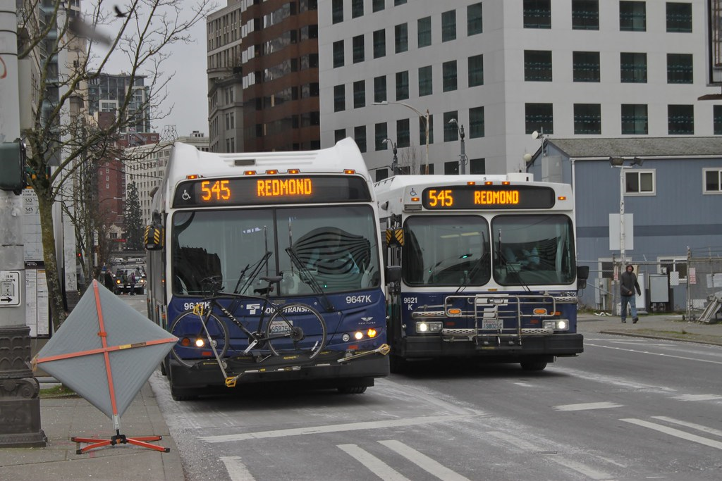
Bus Bunching
With the help of a set of given variables, identify whether or not buses are getting bunched during off-peak hours. If yes, what are the factors causing it?

Slide 15
Data Exploration
49 Variables 6.2 million rows

Slide 16
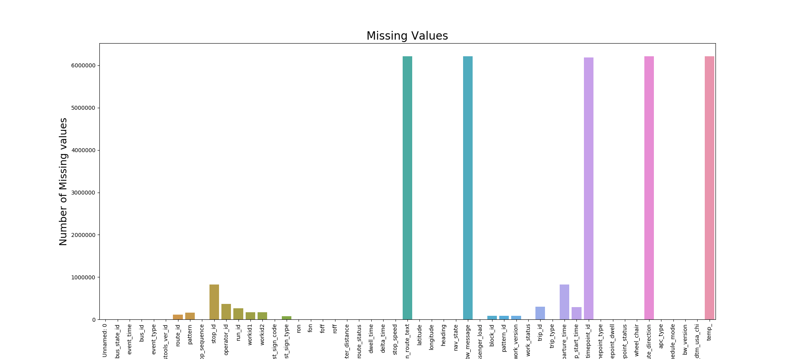
Data Exploration

Slide 17
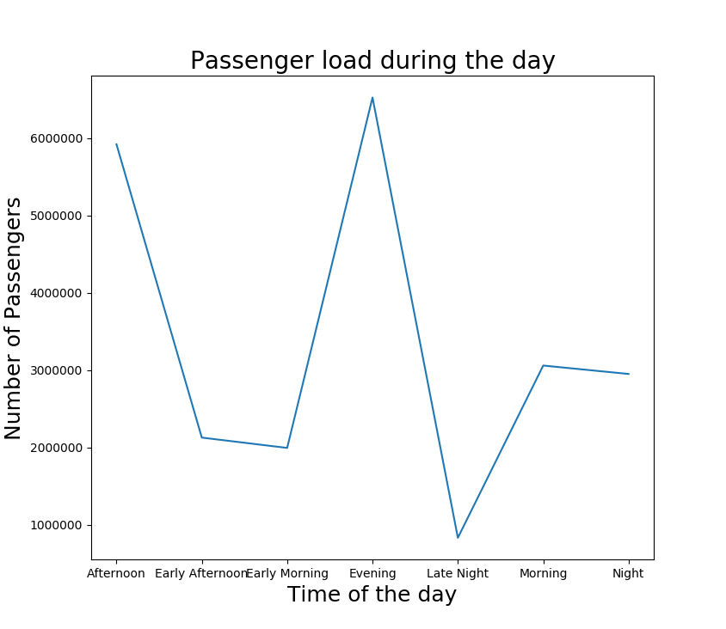
Data Exploration

Slide 18
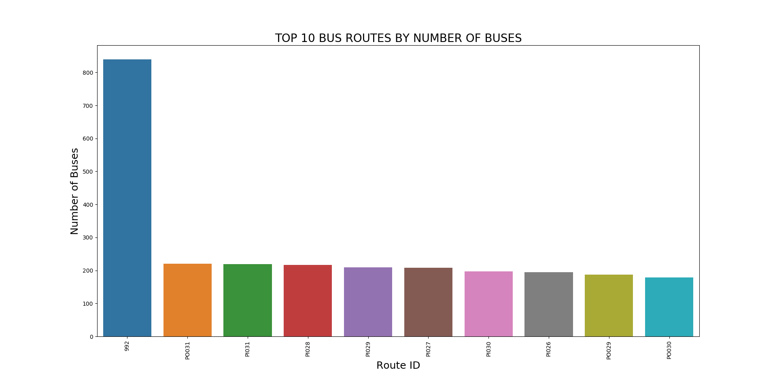
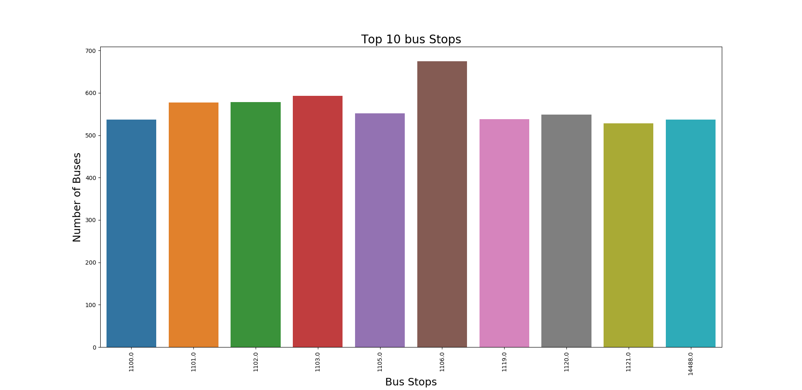
Data Exploration

Slide 19
Data Preprocessing
Buses are said to be bunched if multiple buses arrive at a particular stop within a short span of time
Initial recorded fields approx 6.2mil
Dropping blank columns
Imputing missing values
Dropping untreatable blank values
Final record count 5.6 mil
Subsetting Data based on tuesday
Further slicing based on off peak hours
5 AM - 7 AM
10 AM - 4 PM
7 PM - 11:59 PM

Slide 20
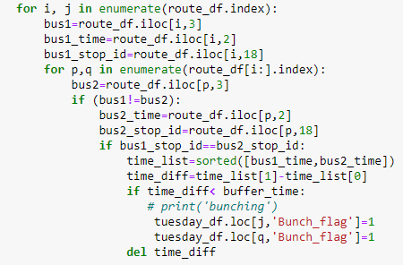
Bus Bunching Logic
Two buses in a particular route and at a particular stop were compared. If the time difference between these buses was found to be less than 5 minutes, they were flagged as bunched.
Approximately 34,000 instances of bunching are recorded
It constitutes about 3% of the total subsetted data

Slide 21
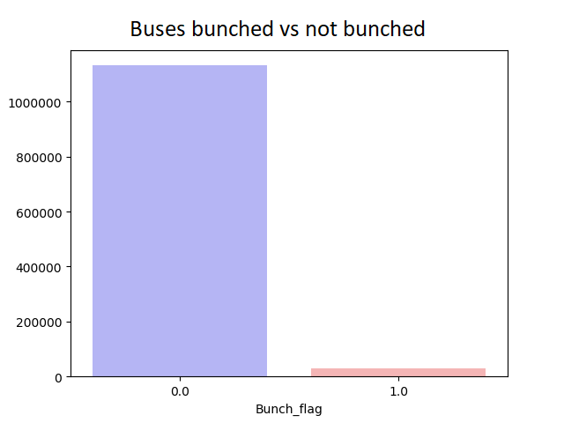
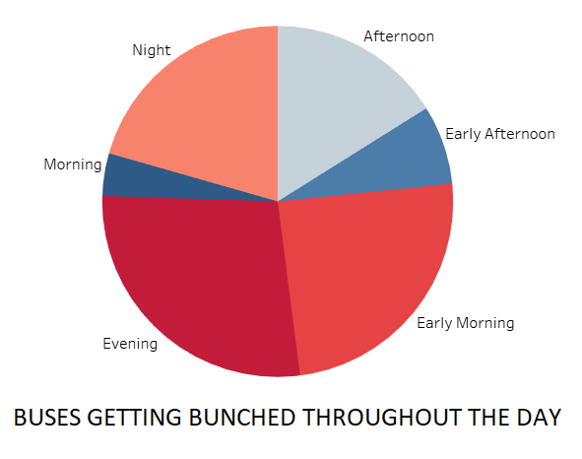
Insights on Bunching

Slide 22
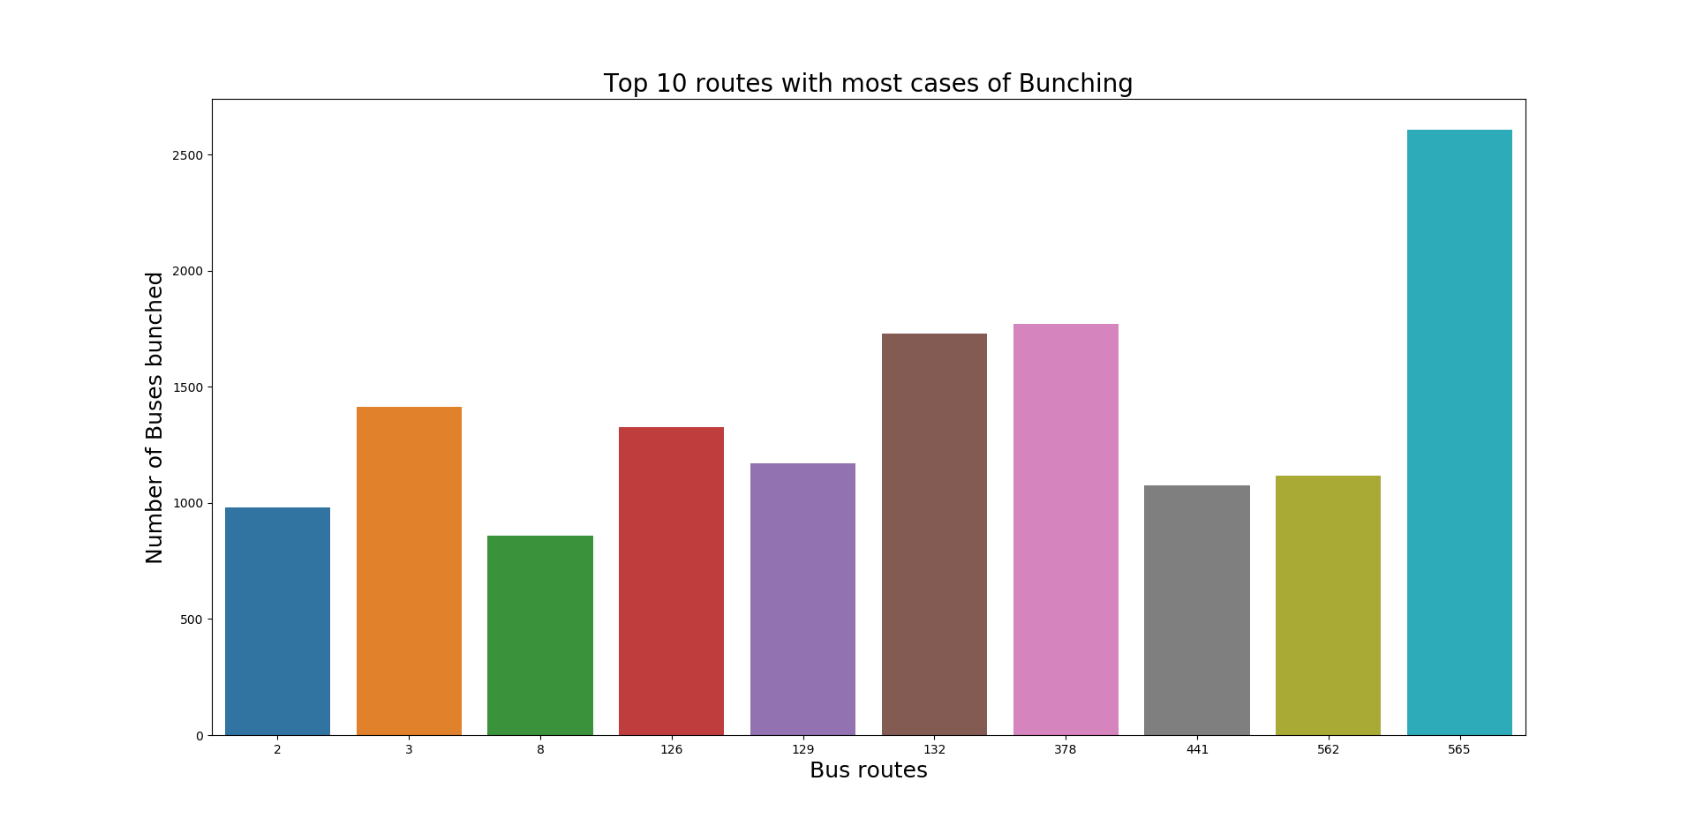
Insights on Bunching

Slide 23
Feature Selection and Modeling
Sixteen Features were selected based on preliminary data analysis and intuition.
‘latitude', 'longitude', 'route_id', 'passenger_load', 'wheel_chair', 'stop_id', 'odometer_distance', 'time', 'stop_sequence', 'Bunch_flag', 'trip_start_time', 'bus_id', 'route_traffic', 'day_of_week','vehicle_life_category', 'offpeak_cat'
Calculated Columns include:
Off_peak_category: Based on which off-peak time frame the bus belonged to
Vehicle_life_category: Based on the odometer readings, buses were categorised into very new, new, old and very old
day_of_week: This corresponds to the day of the week
route_traffic : This is the number of buses running in a particular route throughout the day
Feature Selection Algorithms:
Pearson Correlation
Backward Elimination
Recursive Forward Elimination
Lasso Regularisation
Extra Tree Classifier
Models using selected Feature:
Logistic regression
SGD Regressor
Linear Regression using Neural Networks
Binary Classifier using Neural Networks

Slide 24
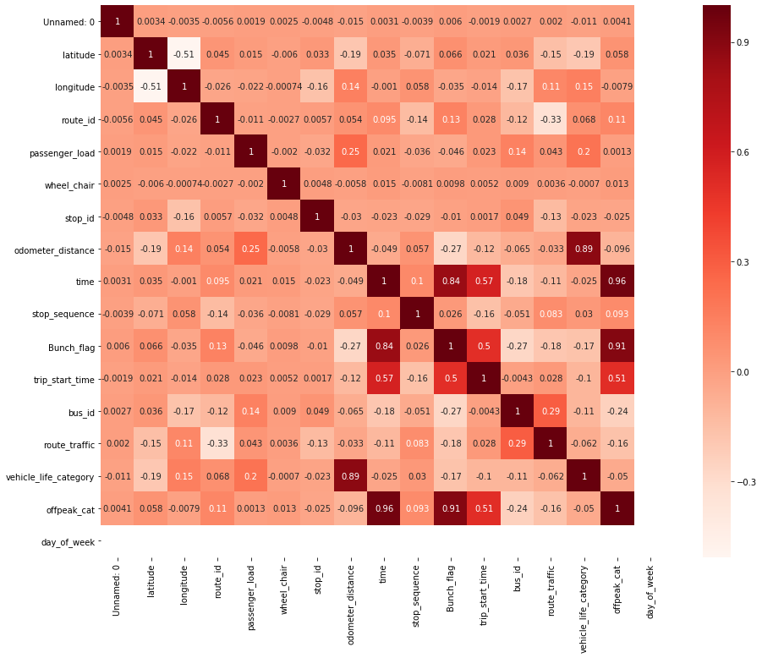
Pearson Correlation
Variables Correlated with Bunch_flag
time
trip_start_time
offpeak_cat
Checking Inter-Feature Correlation
‘time’ and ’trip_start_time’ were correlated
Final Selected Features
trip_start_time
offpeak_cat

Slide 25
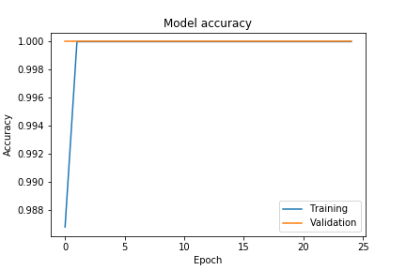
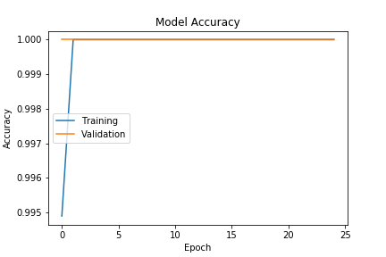
Modeling Using Pearson Correlations
Logistic Regression: Accuracy = 1.0
Stochastic Gradient Descent Regressor: Mean Squared Error = 0.011387275371717095
Mean Absolute Error = 0.04892199759401842
Linear Regression Neural Network: Loss = 4.669129951435676e-10 Accuracy = 1.0
Binary Classifier Neural Network: Loss = 3.335046690252953e-08 Accuracy = 1.0
LRNN
BCNN

Slide 26
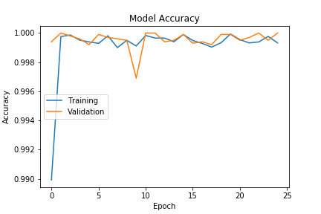
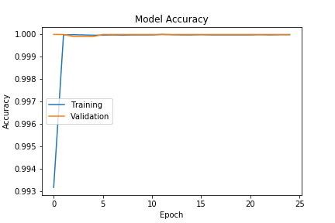
Backward Elimination and Models
Algorithm Selected all 15 variables
Logistic Regression: Accuracy = 0.90
Stochastic Gradient Descent Regressor: Mean Squared Error = 0.02093219979560772
Mean Absolute Error = 0.07184958299853449
Linear Regression Neural Network: Loss = 0.005816894037228789 Accuracy = 1.0
Binary Classifier Neural Network: Loss = 4.669129951435676e-10 Accuracy = 1.0
LRNN
BCNN

Slide 27
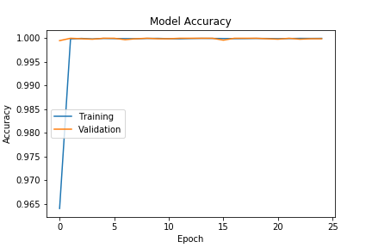
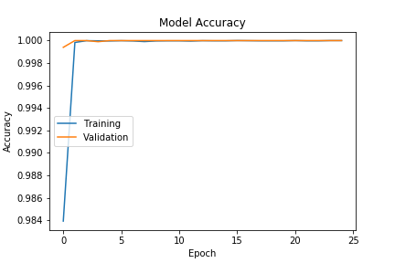
Recursive Forward Elimination and Models
Algorithm Selected 14 variables rejecting 1
Logistic Regression: Accuracy = 0.9
Stochastic Gradient Descent Regressor: Mean Squared Error = 0.01224240938511177
Mean Absolute Error = 0.07002585713524864
Linear Regression Neural Network: Loss = 9.471938436961794e-06 Accuracy = 1.0
Binary Classifier Neural Network: Loss = 1.3796099270674998e-06 Accuracy = 1.0
LRNN
BCNN

Slide 28
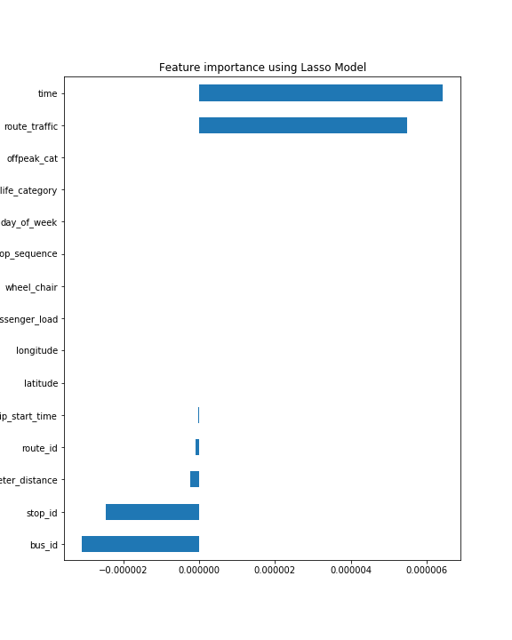
Lasso Regularization
The algorithm Selected 7 variables :
route_id
stop_id
odometer_distance
time
trip_start_time
bus_id
route_traffic

Slide 29
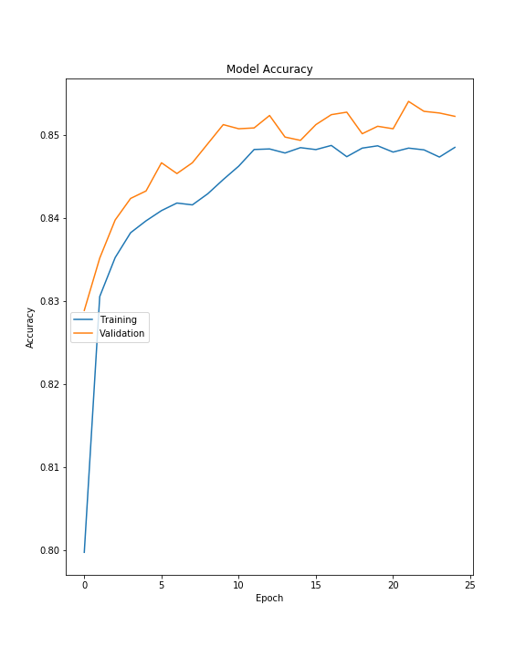
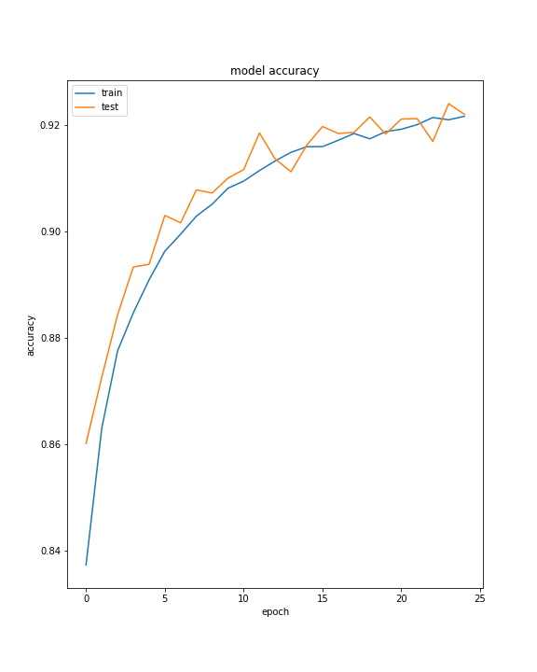
Lasso Regularization And Models
Logistic Regression: Accuracy = 0.90
Stochastic Gradient Descent Regressor: Mean Squared Error = 0.14241076153392296
Mean Absolute Error = 0.3425933680336079
Linear Regression Neural Network: Loss = 0.19991103698346852 Accuracy = 0.7402241826057434
Binary Classifier Neural Network: Loss = 0.3697955107230141 Accuracy = 0.5728515386581421
LRNN
BCNN

Slide 30
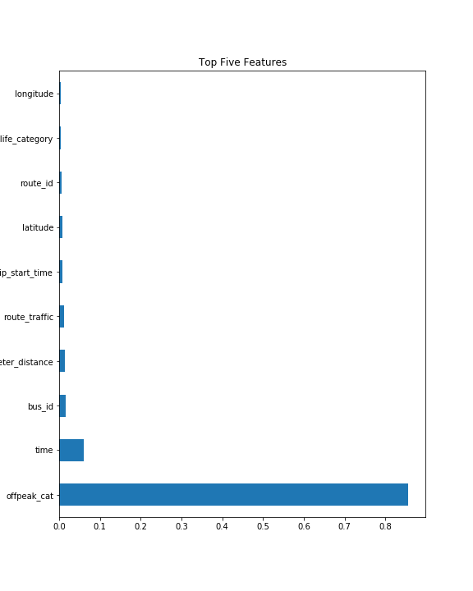
Extra Tree Classifier
The selected variables include:
offpeak_cat
time
bus_id
odometer_distance
route_traffic
trip_start_time
route_id
latitude
vehicle_life_category
longitude

Slide 31
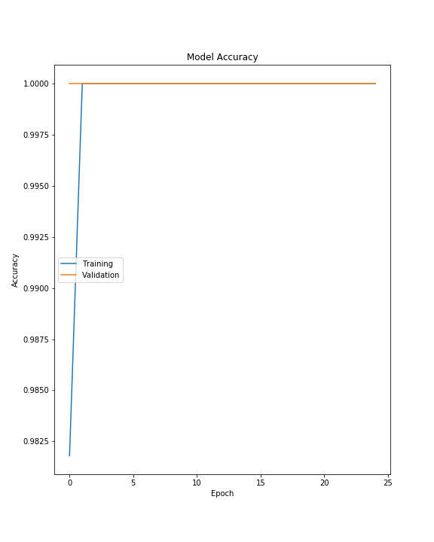
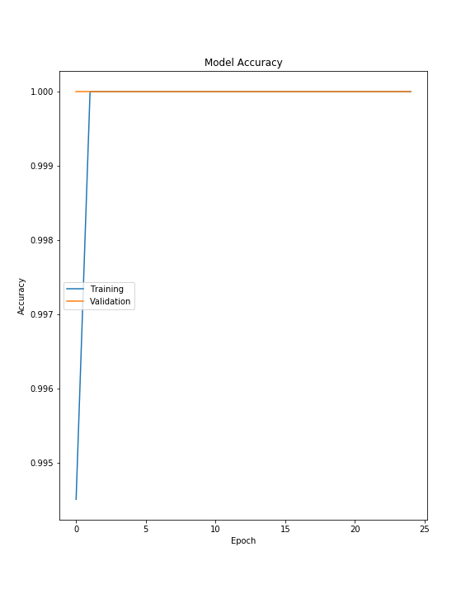
Extra Tree Classifier And Models
Logistic Regression: Accuracy = 0.90
Stochastic Gradient Descent Regressor: Mean Squared Error = 0.011586400406571
Mean Absolute Error = 0.0651147836877358
Linear Regression Neural Network: Loss = 3.0806310570478443e-06 Accuracy = 1.0
Binary Classifier Neural Network: Loss = 3.613446707075829e-11 Accuracy = 1.0
LRNN
BCNN

Slide 32
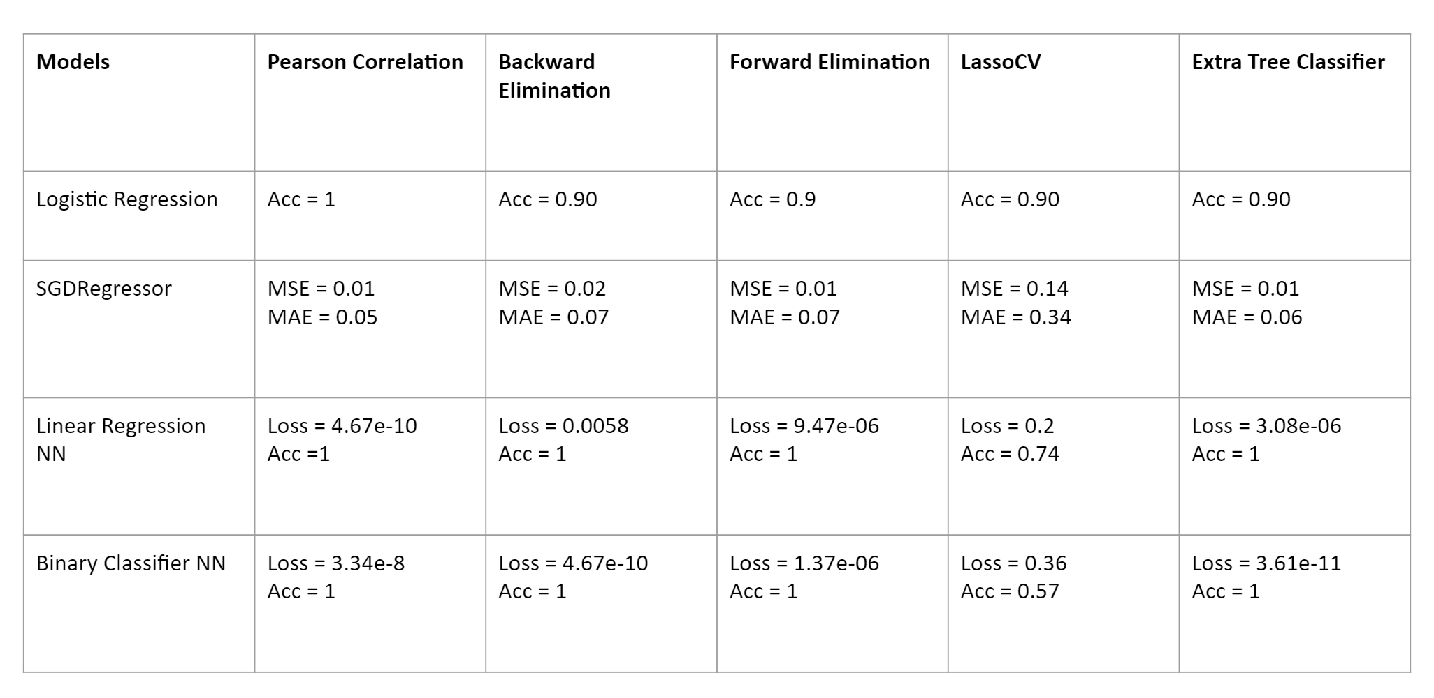
Model Performance Comparison

Slide 33
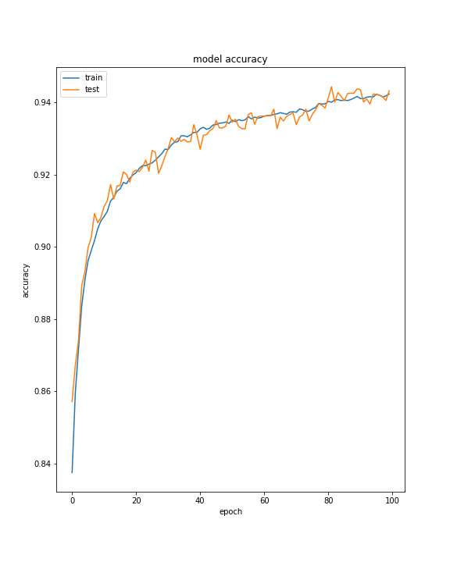
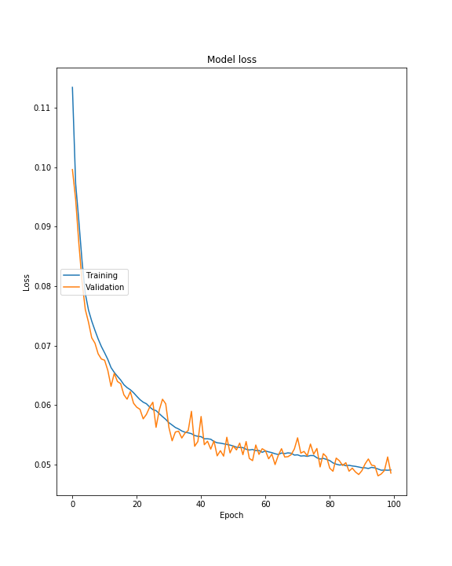
Evaluation of Best Model
Binary Classifier trained on Lasso Regularization variables
Initial training accuracy = 54%
Improved training accuracy = 94.2%
Initial testing accuracy = 57%
Improved testing accuracy = 93.7%
Initial training loss = 40%
Improved training loss = 4.8%
Initial testing loss = 36%
Improved testing loss = 5.2%

Slide 34
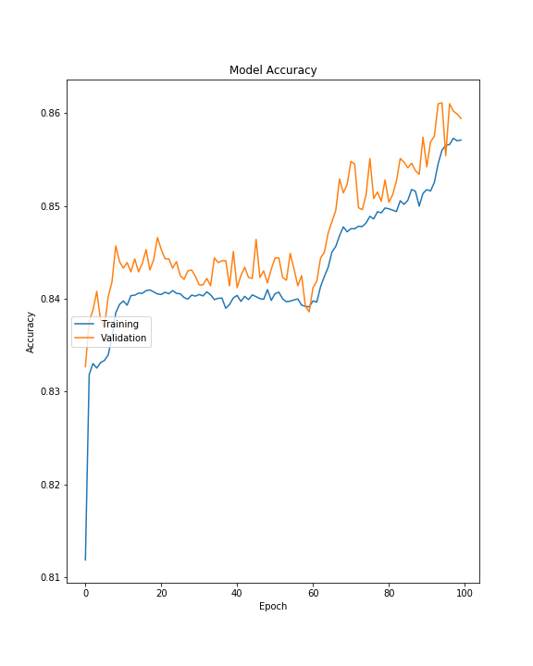
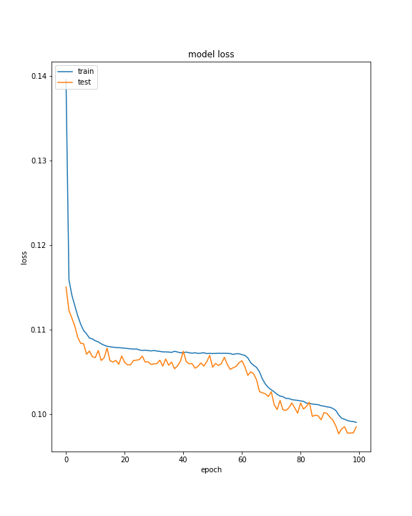
Evaluation of Best Model
Linear Regression NN trained on Lasso Regularization variables
Initial training accuracy = 78%
Improved training accuracy = 85%
Initial testing accuracy = 74%
Improved testing accuracy = 85%
Initial training loss = 18%
Improved training loss= 7%
Initial testing loss = 20%
Improved testing loss = 9%

Slide 35
Conclusion
Based on the analysis done, the variables below have an impact on bus bunching
route_id
stop_id
odometer_distance
time
trip_start_time
bus_id
route_traffic
These variables can be used to predict future bunching instances
Same model can be extended to any day of the week or any time-frame
Overall, only very few buses are getting bunched during off peak hours

Slide 36
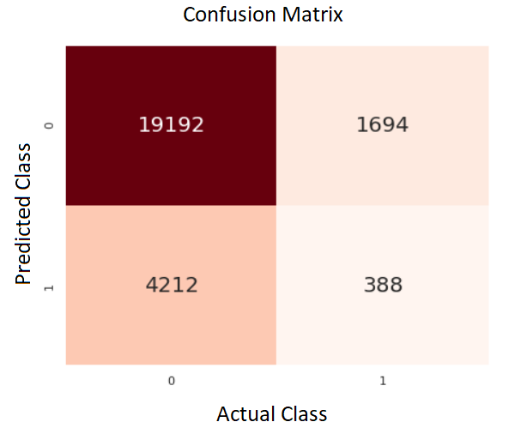
Time Series Analysis
Build LSTM network time series analysis model
Training Accuracy = 96.38 %
Test accuracy = 76.82 %
Precision = 18.63 %
Recall = 8.43 %
F1 score = 11.61 %

Slide 37
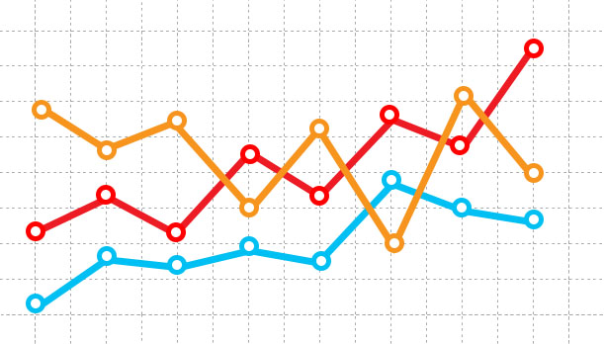
Federal Reporting
Transit agencies must report financial information on an annual basis using accrual accounting and the NTD Uniform System of Accounts (USOA) to get funding to continue operations.
CTA Operations team wanted us to help them with this Federal Reporting by calculating the following matrices-
Vehicle miles travel both in service and out of service
Vehicles hours spent

Slide 38
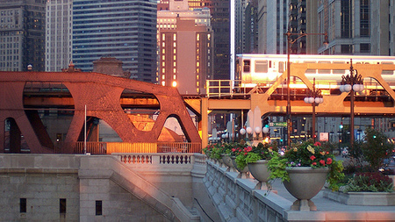
Thank you for riding the CTA!

